Slide 1

Development - Java fundamentals

Slide 2
I
Java fundamentals

Slide 3
Prerequisites
Bullet examples
JDK 1.15
Download from https://jdk.java.net/15/
Extract zip file into a folder (e.g.: C:\Program Files\Java\jdk-15.0.2)
Add the location of the bin folder of the JDK installation to the PATH variable in System Variables
Set JAVA_HOME: Under System Variables, click New -> Enter the variable name as JAVA_HOME -> Enter the variable value as the installation path of the JDK (e.g., C:\Program Files\Java\jdk-15.0.2)
To test installation -> Open the Command Prompt and type java –version
Intellij IDEA Ultimate
https://www.jetbrains.com/community/education/#students – free license for students using the university email
Github repo : https://github.com/diana-stoica-ub/java-fundamentals
Numeric Lists
Notes:
Standard text slide (version 5)
Creating visual differences in text-heavy pages keeps the audience interested and engaged.
Using bold and highlighted coloured text draws the reader into the important part of the text. Use this sparing throughout the text, if it is used too much, the page becomes busy, it loses its’ meaning.
Varying the length of the paragraphs as well as using bulleted and numeric lists help with keeping the reader engaged. Lists help to “skim” the information on the page and allow the audience to absorb a just the key information.

Slide 4

Agenda
Introduction to java
Classes and objects
Inheritance
Composition and aggregation
Comparable and comparator
Generics
Arrays and collections
Exceptions
Functional programming in java
Reflection
multithreading
Notes:
Agenda
General Template Guidance: Information to help you make good presentations.
Standard / Static Slides: Some key Endava slides/lockups that, in general, should only be modified by marketing.
Template Slides: A selection of template slides for use in Endava presentations.
Larger Format Template Slides: Template slides with larger content.
Icon Library: A selection of hundreds of icons to use in Endava presentations.

Slide 5

1
Introduction to Java
Examples in package section1_introduction
Notes:
Chapter Intro Slide (version C)
This slide should be used at the beginning of each “chapter” of your presentation (as introduced in the Agenda slide) to keep the audience aware of their place in the story and to help break things up. Change the text and chapter number accordingly. If you do not need a sub-head (the smaller text), delete it. Use different backgrounds for different chapter titles, try not to repeat a background.
Very short presentations (< ~10 slides) may not need Chapter Intro Slides.
There are multiple versions of this template with various white and black background images starting on slide 10.

Slide 6
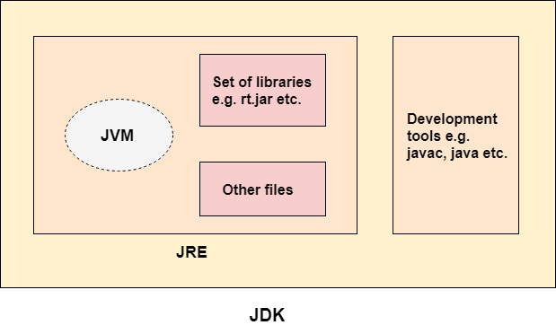
About Java
Object-oriented programming language
Case sensitive
Platform-independent, portable (because of the JVM – Java Virtual Machine)
Numeric Lists
.java (source code file)
Compiler (javac)
.class (java bytecode)
JVM (java, bytecode)
Operating System instructions
JVM = Java Virtual Machine
JRE = Java Runtime Environment – contains everything needed for running Java applications (including the JVM)
JDK = Java Development Kit – contains everything needed for developing Java applications (including the JRE)
Notes:
Standard text slide (version 5)
Creating visual differences in text-heavy pages keeps the audience interested and engaged.
Using bold and highlighted coloured text draws the reader into the important part of the text. Use this sparing throughout the text, if it is used too much, the page becomes busy, it loses its’ meaning.
Varying the length of the paragraphs as well as using bulleted and numeric lists help with keeping the reader engaged. Lists help to “skim” the information on the page and allow the audience to absorb a just the key information.

Slide 7
Structure of a Java application
Primitives – simple data types
Classes – complex data types, abstractions over real life concepts (keyword: class)
Object – instance of a class; memory is allocated
Classes are grouped into packages (keyword: package)
Main method – starting point of the Java program ( public static void main(String[] args) {…}
null – absence of reference, unallocated variable
import – if we need to use classes from other packages (package java.lang is imported by default)
Parameters – passed by value (but when the parameter is an object, its value is actually the reference!)
Notes:
Standard text slide (version 5)
Creating visual differences in text-heavy pages keeps the audience interested and engaged.
Using bold and highlighted coloured text draws the reader into the important part of the text. Use this sparing throughout the text, if it is used too much, the page becomes busy, it loses its’ meaning.
Varying the length of the paragraphs as well as using bulleted and numeric lists help with keeping the reader engaged. Lists help to “skim” the information on the page and allow the audience to absorb a just the key information.

Slide 8
2
Classes and objects
Code examples in package section2_classes
Notes:
Chapter Intro Slide (version C)
This slide should be used at the beginning of each “chapter” of your presentation (as introduced in the Agenda slide) to keep the audience aware of their place in the story and to help break things up. Change the text and chapter number accordingly. If you do not need a sub-head (the smaller text), delete it. Use different backgrounds for different chapter titles, try not to repeat a background.
Very short presentations (< ~10 slides) may not need Chapter Intro Slides.
There are multiple versions of this template with various white and black background images starting on slide 10.

Slide 9
Classes
Bullet examples
A class contains:
Methods – functionality, executable code
Constructors – special methods that are used to create an instance of a class
Attributes – properties, object’s state
Keyword this – current object reference
Numeric Lists
Access modifiers:
private – visibility only in class; can be used on classes (internal), methods, attributes
Default package (no access modifier) – package level visibility; can be used on classes, methods, attributes
protected – visibility inside the package and child classes; can be used on classes (internal), methods, attributes
public - visibility outside of the package; can pe used on classes, methods, attributes
Enum – special kind of class that can map a series of constants
Notes:
Standard text slide (version 5)
Creating visual differences in text-heavy pages keeps the audience interested and engaged.
Using bold and highlighted coloured text draws the reader into the important part of the text. Use this sparing throughout the text, if it is used too much, the page becomes busy, it loses its’ meaning.
Varying the length of the paragraphs as well as using bulleted and numeric lists help with keeping the reader engaged. Lists help to “skim” the information on the page and allow the audience to absorb a just the key information.

Slide 10
Static keyword
Bullet examples
Static structures belong to the class rather than the object
Keyword: static
Static fields : only one instance is created in memory; each instance can access and modify it.
Static methods
Static blocks
Static nested classes
When using a static field / method, there is no need to create an instance in order to use it.L
Notes:
Standard text slide (version 5)
Creating visual differences in text-heavy pages keeps the audience interested and engaged.
Using bold and highlighted coloured text draws the reader into the important part of the text. Use this sparing throughout the text, if it is used too much, the page becomes busy, it loses its’ meaning.
Varying the length of the paragraphs as well as using bulleted and numeric lists help with keeping the reader engaged. Lists help to “skim” the information on the page and allow the audience to absorb a just the key information.

Slide 11
Final keyword
Bullet examples
Keyword: final
Final attribute / variable : cannot be modified (they become constants)
Final methods : cannot be overridden
Final class: cannot be extended
Notes:
Standard text slide (version 5)
Creating visual differences in text-heavy pages keeps the audience interested and engaged.
Using bold and highlighted coloured text draws the reader into the important part of the text. Use this sparing throughout the text, if it is used too much, the page becomes busy, it loses its’ meaning.
Varying the length of the paragraphs as well as using bulleted and numeric lists help with keeping the reader engaged. Lists help to “skim” the information on the page and allow the audience to absorb a just the key information.

Slide 12
Arrays
Bullet examples
an ordered collection of primitives / objects of the same type
each element has an index (starting from 0)
fixed size
java.util.Arrays -> useful methods for array manipulation
Notes:
Standard text slide (version 5)
Creating visual differences in text-heavy pages keeps the audience interested and engaged.
Using bold and highlighted coloured text draws the reader into the important part of the text. Use this sparing throughout the text, if it is used too much, the page becomes busy, it loses its’ meaning.
Varying the length of the paragraphs as well as using bulleted and numeric lists help with keeping the reader engaged. Lists help to “skim” the information on the page and allow the audience to absorb a just the key information.

Slide 13
Strings
Bullet examples
characters sequence
internally backed by a char-array
String are immutable – this means that once initialized, we cannot change it’s value
StringBuilder and StringBuffer (synchronized) can be used if we need mutable character sequences
Notes:
Standard text slide (version 5)
Creating visual differences in text-heavy pages keeps the audience interested and engaged.
Using bold and highlighted coloured text draws the reader into the important part of the text. Use this sparing throughout the text, if it is used too much, the page becomes busy, it loses its’ meaning.
Varying the length of the paragraphs as well as using bulleted and numeric lists help with keeping the reader engaged. Lists help to “skim” the information on the page and allow the audience to absorb a just the key information.

Slide 14
3
Inheritance
Code examples in package section3_inheritance
Notes:
Chapter Intro Slide (version C)
This slide should be used at the beginning of each “chapter” of your presentation (as introduced in the Agenda slide) to keep the audience aware of their place in the story and to help break things up. Change the text and chapter number accordingly. If you do not need a sub-head (the smaller text), delete it. Use different backgrounds for different chapter titles, try not to repeat a background.
Very short presentations (< ~10 slides) may not need Chapter Intro Slides.
There are multiple versions of this template with various white and black background images starting on slide 10.

Slide 15
Object Oriented Programming Principles
Bullet examples
Encapsulation – the state and functionalities of a class are hidden from others (private); access only via non-private methods
Abstraction – hiding implementation details, only reveal operations that are relevant for other classes
Inheritance – a class can extend another class and it inherits its state and functionality
Polymorphism – ability of an object to take many forms (e.g.: if A extends B, then an instance of class A is an A, but also a B, and an Object)
Notes:
Standard text slide (version 5)
Creating visual differences in text-heavy pages keeps the audience interested and engaged.
Using bold and highlighted coloured text draws the reader into the important part of the text. Use this sparing throughout the text, if it is used too much, the page becomes busy, it loses its’ meaning.
Varying the length of the paragraphs as well as using bulleted and numeric lists help with keeping the reader engaged. Lists help to “skim” the information on the page and allow the audience to absorb a just the key information.

Slide 16
Classes inheritance
Bullet examples
Keyword: extends
A child class inherits the functionality of the parent class, and can add new more specialized functionality or override its existing methods
All classes in Java extend by default the Object class
In Java, a class can extend only one class.
Keyword super – parent class reference
Numeric Lists
Notes:
Standard text slide (version 5)
Creating visual differences in text-heavy pages keeps the audience interested and engaged.
Using bold and highlighted coloured text draws the reader into the important part of the text. Use this sparing throughout the text, if it is used too much, the page becomes busy, it loses its’ meaning.
Varying the length of the paragraphs as well as using bulleted and numeric lists help with keeping the reader engaged. Lists help to “skim” the information on the page and allow the audience to absorb a just the key information.

Slide 17
Interfaces
Bullet examples
Keyword: interface
can only contain method signatures and constant fields (public static final - constants; must be initialized)
since Java 8 - we can provide default implementation for methods (keyword: default)
methods and fields are all public (even if the public keyword is missing)
access modifiers: public or default package
since Java 9 – private methods
before using an interface, we need a class to implement it (an interface cannot be instantiated!) - keyword implements
a class can implement multiple interfaces
a class that implements an interface must implement all its methods (except default ones)
interfaces can have static methods; they need to be implemented
an interface can inherit other interfaces (keyword extends)
Numeric Lists
Notes:
Standard text slide (version 5)
Creating visual differences in text-heavy pages keeps the audience interested and engaged.
Using bold and highlighted coloured text draws the reader into the important part of the text. Use this sparing throughout the text, if it is used too much, the page becomes busy, it loses its’ meaning.
Varying the length of the paragraphs as well as using bulleted and numeric lists help with keeping the reader engaged. Lists help to “skim” the information on the page and allow the audience to absorb a just the key information.

Slide 18
Abstract classes
Bullet examples
Keyword: abstract
class that can contain 'abstract' methods (without implementation)
can contain non-constant fields
can use different access modifiers (not everything is public by default, like with interfaces)
can have constructors but can't be instantiated!
Notes:
Standard text slide (version 5)
Creating visual differences in text-heavy pages keeps the audience interested and engaged.
Using bold and highlighted coloured text draws the reader into the important part of the text. Use this sparing throughout the text, if it is used too much, the page becomes busy, it loses its’ meaning.
Varying the length of the paragraphs as well as using bulleted and numeric lists help with keeping the reader engaged. Lists help to “skim” the information on the page and allow the audience to absorb a just the key information.

Slide 19
4
Composition & Aggregation
Code examples in package section4_composition_aggregation
Notes:
Chapter Intro Slide (version C)
This slide should be used at the beginning of each “chapter” of your presentation (as introduced in the Agenda slide) to keep the audience aware of their place in the story and to help break things up. Change the text and chapter number accordingly. If you do not need a sub-head (the smaller text), delete it. Use different backgrounds for different chapter titles, try not to repeat a background.
Very short presentations (< ~10 slides) may not need Chapter Intro Slides.
There are multiple versions of this template with various white and black background images starting on slide 10.

Slide 20
Aggregation
Bullet examples
represents a Has-A relationship.
It is a unidirectional association, e.g.: a department can have students
both entries can survive individually which means ending one entity will not affect the other entity
Notes:
Standard text slide (version 5)
Creating visual differences in text-heavy pages keeps the audience interested and engaged.
Using bold and highlighted coloured text draws the reader into the important part of the text. Use this sparing throughout the text, if it is used too much, the page becomes busy, it loses its’ meaning.
Varying the length of the paragraphs as well as using bulleted and numeric lists help with keeping the reader engaged. Lists help to “skim” the information on the page and allow the audience to absorb a just the key information.

Slide 21
Composition
Bullet examples
It represents part-of relationship.
In composition, both the entities are dependent on each other.
the contained class cannot exist independently of the container. If the container is destroyed, the child is also destroyed (e.g.: a Book has Chapters, when a Book is destroyed, there is no need for its Chapters to exist anymore)
Notes:
Standard text slide (version 5)
Creating visual differences in text-heavy pages keeps the audience interested and engaged.
Using bold and highlighted coloured text draws the reader into the important part of the text. Use this sparing throughout the text, if it is used too much, the page becomes busy, it loses its’ meaning.
Varying the length of the paragraphs as well as using bulleted and numeric lists help with keeping the reader engaged. Lists help to “skim” the information on the page and allow the audience to absorb a just the key information.

Slide 22
5
Comparable and Comparator
Code examples in package section5_comparing
Notes:
Chapter Intro Slide (version C)
This slide should be used at the beginning of each “chapter” of your presentation (as introduced in the Agenda slide) to keep the audience aware of their place in the story and to help break things up. Change the text and chapter number accordingly. If you do not need a sub-head (the smaller text), delete it. Use different backgrounds for different chapter titles, try not to repeat a background.
Very short presentations (< ~10 slides) may not need Chapter Intro Slides.
There are multiple versions of this template with various white and black background images starting on slide 10.

Slide 23
Comparable
Bullet examples
A comparable object can compare itself with another object.
The class itself must implement the java.lang.Comparable interface. This interface imposes a total ordering on the objects of each class that implements it. This ordering is referred to as the class's natural ordering, and the class's compareTo method is referred to as its natural comparison method.
public int compareTo(Object obj): It is used to compare the current object with the specified object. It returns:
positive integer, if the current object is greater than the specified object.
negative integer, if the current object is less than the specified object.
zero, if the current object is equal to the specified object.
Notes:
Standard text slide (version 5)
Creating visual differences in text-heavy pages keeps the audience interested and engaged.
Using bold and highlighted coloured text draws the reader into the important part of the text. Use this sparing throughout the text, if it is used too much, the page becomes busy, it loses its’ meaning.
Varying the length of the paragraphs as well as using bulleted and numeric lists help with keeping the reader engaged. Lists help to “skim” the information on the page and allow the audience to absorb a just the key information.

Slide 24
Comparator
Bullet examples
Unlike Comparable, a Comparator is external to the element type we are comparing.
It’s a separate class. We create multiple separate classes (that implement java.util.Comparator) to compare by different members.
To compare objects using a comparator, we need to:
Create a class that implements Comparator (and the compare() method that does the work previously done by compareTo()).
The compare() method in Java compares two class specific objects (x, y) given as parameters. It returns 0 (if x == y), 1 (if x > y) or -1 (if x < y)
Notes:
Standard text slide (version 5)
Creating visual differences in text-heavy pages keeps the audience interested and engaged.
Using bold and highlighted coloured text draws the reader into the important part of the text. Use this sparing throughout the text, if it is used too much, the page becomes busy, it loses its’ meaning.
Varying the length of the paragraphs as well as using bulleted and numeric lists help with keeping the reader engaged. Lists help to “skim” the information on the page and allow the audience to absorb a just the key information.

Slide 25
6
Generics
Code examples in package section6_generics
Notes:
Chapter Intro Slide (version C)
This slide should be used at the beginning of each “chapter” of your presentation (as introduced in the Agenda slide) to keep the audience aware of their place in the story and to help break things up. Change the text and chapter number accordingly. If you do not need a sub-head (the smaller text), delete it. Use different backgrounds for different chapter titles, try not to repeat a background.
Very short presentations (< ~10 slides) may not need Chapter Intro Slides.
There are multiple versions of this template with various white and black background images starting on slide 10.

Slide 26
Generics
Bullet examples
Java Generic methods and generic classes enable programmers to specify, with a single method declaration, a set of related methods, or with a single class declaration, a set of related types, respectively.
Using Java Generic concept, we might write a generic method for sorting an array of objects, then invoke the generic method with Integer arrays, Double arrays, String arrays and so on, to sort the array elements.
Notes:
Standard text slide (version 5)
Creating visual differences in text-heavy pages keeps the audience interested and engaged.
Using bold and highlighted coloured text draws the reader into the important part of the text. Use this sparing throughout the text, if it is used too much, the page becomes busy, it loses its’ meaning.
Varying the length of the paragraphs as well as using bulleted and numeric lists help with keeping the reader engaged. Lists help to “skim” the information on the page and allow the audience to absorb a just the key information.

Slide 27
Generic methods
Bullet examples
You can write a single generic method declaration that can be called with arguments of different types.
Based on the types of the arguments passed to the generic method, the compiler handles each method call appropriately.
All generic method declarations have a type parameter section delimited by angle brackets (< and >) that precedes the method's return type ( < E >).
Each type parameter section contains one or more type parameters separated by commas.
A type parameter, also known as a type variable, is an identifier that specifies a generic type name.
The type parameters can be used to declare the return type and act as placeholders for the types of the arguments passed to the generic method, which are known as actual type arguments.
A generic method's body is declared like that of any other method.
Type parameters can represent only reference types, not primitive types.
Notes:
Standard text slide (version 5)
Creating visual differences in text-heavy pages keeps the audience interested and engaged.
Using bold and highlighted coloured text draws the reader into the important part of the text. Use this sparing throughout the text, if it is used too much, the page becomes busy, it loses its’ meaning.
Varying the length of the paragraphs as well as using bulleted and numeric lists help with keeping the reader engaged. Lists help to “skim” the information on the page and allow the audience to absorb a just the key information.

Slide 28
Bounded types
Bullet examples
There may be times when you'll want to restrict the kinds of types that are allowed to be passed to a type parameter. For example, a method that operates on numbers might only want to accept instances of Number or its subclasses. This is what bounded type parameters are for.
To declare a bounded type parameter, list the type parameter's name, followed by the extends keyword, followed by its upper bound.
Notes:
Standard text slide (version 5)
Creating visual differences in text-heavy pages keeps the audience interested and engaged.
Using bold and highlighted coloured text draws the reader into the important part of the text. Use this sparing throughout the text, if it is used too much, the page becomes busy, it loses its’ meaning.
Varying the length of the paragraphs as well as using bulleted and numeric lists help with keeping the reader engaged. Lists help to “skim” the information on the page and allow the audience to absorb a just the key information.

Slide 29
Wildcards
Bullet examples
“?”- used to refer to an unknown type.
Object is the supertype of all Java classes, but, a collection of Object is not the supertype of any collection. (e.g.: List<Object> is not the supertype of List<String> => assigning a variable of type List<Object> to a variable of type List<String> will cause a compiler error)
Wildcards can be used with both upper bounding (extends) and lower bounding(super)
Notes:
Standard text slide (version 5)
Creating visual differences in text-heavy pages keeps the audience interested and engaged.
Using bold and highlighted coloured text draws the reader into the important part of the text. Use this sparing throughout the text, if it is used too much, the page becomes busy, it loses its’ meaning.
Varying the length of the paragraphs as well as using bulleted and numeric lists help with keeping the reader engaged. Lists help to “skim” the information on the page and allow the audience to absorb a just the key information.

Slide 30
Generic classes
Bullet examples
It A generic class declaration looks like a non-generic class declaration, except that the class name is followed by a type parameter section.
As with generic methods, the type parameter section of a generic class can have one or more type parameters separated by commas.
These classes are known as parameterized classes or parameterized types because they accept one or more parameters.
Resources:
https://docs.oracle.com/javase/tutorial/java/generics/index.html
https://www.baeldung.com/java-generics
https://www.baeldung.com/java-generics-vs-extends-object
Notes:
Standard text slide (version 5)
Creating visual differences in text-heavy pages keeps the audience interested and engaged.
Using bold and highlighted coloured text draws the reader into the important part of the text. Use this sparing throughout the text, if it is used too much, the page becomes busy, it loses its’ meaning.
Varying the length of the paragraphs as well as using bulleted and numeric lists help with keeping the reader engaged. Lists help to “skim” the information on the page and allow the audience to absorb a just the key information.

Slide 31
7
Collections
Code examples in package section7_collections
Notes:
Chapter Intro Slide (version C)
This slide should be used at the beginning of each “chapter” of your presentation (as introduced in the Agenda slide) to keep the audience aware of their place in the story and to help break things up. Change the text and chapter number accordingly. If you do not need a sub-head (the smaller text), delete it. Use different backgrounds for different chapter titles, try not to repeat a background.
Very short presentations (< ~10 slides) may not need Chapter Intro Slides.
There are multiple versions of this template with various white and black background images starting on slide 10.

Slide 32
Collections Framework
Bullet examples
package: java.util
The collections framework contains:
Interfaces
Implementations
Algorithms
Collections offer implementations for:
List (list of elements)
Map (key-value pairs)
Set (unique elements)
Collection interface – implemented by most of the collections
Collections class – static methods useful for working with collections
Notes:
Standard text slide (version 5)
Creating visual differences in text-heavy pages keeps the audience interested and engaged.
Using bold and highlighted coloured text draws the reader into the important part of the text. Use this sparing throughout the text, if it is used too much, the page becomes busy, it loses its’ meaning.
Varying the length of the paragraphs as well as using bulleted and numeric lists help with keeping the reader engaged. Lists help to “skim” the information on the page and allow the audience to absorb a just the key information.

Slide 33
Iteration
Bullet examples
We can iterate over a collection:
Using a for-each loop
Using an Iterator:
-> .iterator() method to obtain it
-> Iterator interface
-> using an Iterator, we can delete elements at the same time (not possible with for-each loop)
Notes:
Standard text slide (version 5)
Creating visual differences in text-heavy pages keeps the audience interested and engaged.
Using bold and highlighted coloured text draws the reader into the important part of the text. Use this sparing throughout the text, if it is used too much, the page becomes busy, it loses its’ meaning.
Varying the length of the paragraphs as well as using bulleted and numeric lists help with keeping the reader engaged. Lists help to “skim” the information on the page and allow the audience to absorb a just the key information.

Slide 34
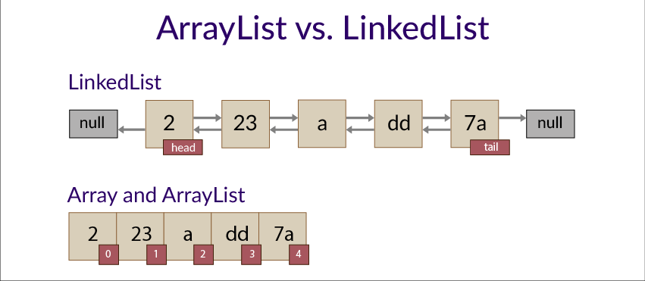
List
Bullet examples
data structure: array, dynamic list
ListIterator – interface that extends Iterator and provides reverse order iteration
Implementations:
ArrayList – good for reads
LinkedList – good for writes
Notes:
Standard text slide (version 5)
Creating visual differences in text-heavy pages keeps the audience interested and engaged.
Using bold and highlighted coloured text draws the reader into the important part of the text. Use this sparing throughout the text, if it is used too much, the page becomes busy, it loses its’ meaning.
Varying the length of the paragraphs as well as using bulleted and numeric lists help with keeping the reader engaged. Lists help to “skim” the information on the page and allow the audience to absorb a just the key information.

Slide 35
Set
Bullet examples
unique elements
Implementations:
HashSet:
-> uses a hash table
-> does not guarantee order
LinkedHashSet
-> uses a hash table
-> guarantees the insertion order
TreeSet
-> uses a red-black tree
-> keeps the elements sorted
Notes:
Standard text slide (version 5)
Creating visual differences in text-heavy pages keeps the audience interested and engaged.
Using bold and highlighted coloured text draws the reader into the important part of the text. Use this sparing throughout the text, if it is used too much, the page becomes busy, it loses its’ meaning.
Varying the length of the paragraphs as well as using bulleted and numeric lists help with keeping the reader engaged. Lists help to “skim” the information on the page and allow the audience to absorb a just the key information.

Slide 36
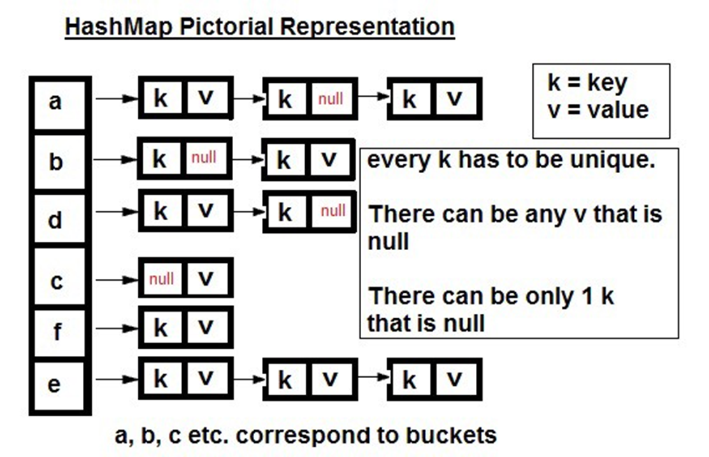
Map
Bullet examples
Key – value pairs (keys must be unique)
Map.Entry interface – models the key-value pair
Implementations:
HashMap:
-> uses a hash table
-> does not guarantee order
LinkedHashMap
-> uses a hash table
-> guarantees the insertion order
TreeMap
-> uses a red-black tree
-> keeps the elements sorted
Notes:
Standard text slide (version 5)
Creating visual differences in text-heavy pages keeps the audience interested and engaged.
Using bold and highlighted coloured text draws the reader into the important part of the text. Use this sparing throughout the text, if it is used too much, the page becomes busy, it loses its’ meaning.
Varying the length of the paragraphs as well as using bulleted and numeric lists help with keeping the reader engaged. Lists help to “skim” the information on the page and allow the audience to absorb a just the key information.

Slide 37
Equals – hashcode contract
Bullet examples
If we override equals () -> we must also override hashCode()
If we use a hash-based collection, we must override both of them
Contract:
If we call hashCode() multiple times on the same object -> same result
If obj1.equals(obj2) -> hashcode obj1 == hashcode obj2
If !obj1.equals(obj2) -> hashcodes don’t have to be different, but it’s recommended.
Notes:
Standard text slide (version 5)
Creating visual differences in text-heavy pages keeps the audience interested and engaged.
Using bold and highlighted coloured text draws the reader into the important part of the text. Use this sparing throughout the text, if it is used too much, the page becomes busy, it loses its’ meaning.
Varying the length of the paragraphs as well as using bulleted and numeric lists help with keeping the reader engaged. Lists help to “skim” the information on the page and allow the audience to absorb a just the key information.

Slide 38
Resources
Bullet examples
https://docs.oracle.com/javase/tutorial/collections/
https://www.baeldung.com/java-collections
Notes:
Standard text slide (version 5)
Creating visual differences in text-heavy pages keeps the audience interested and engaged.
Using bold and highlighted coloured text draws the reader into the important part of the text. Use this sparing throughout the text, if it is used too much, the page becomes busy, it loses its’ meaning.
Varying the length of the paragraphs as well as using bulleted and numeric lists help with keeping the reader engaged. Lists help to “skim” the information on the page and allow the audience to absorb a just the key information.

Slide 39
8
Exceptions
Code examples in package section8_exceptions
Notes:
Chapter Intro Slide (version C)
This slide should be used at the beginning of each “chapter” of your presentation (as introduced in the Agenda slide) to keep the audience aware of their place in the story and to help break things up. Change the text and chapter number accordingly. If you do not need a sub-head (the smaller text), delete it. Use different backgrounds for different chapter titles, try not to repeat a background.
Very short presentations (< ~10 slides) may not need Chapter Intro Slides.
There are multiple versions of this template with various white and black background images starting on slide 10.

Slide 40
Exception handling
Bullet examples
We can handle an exception by:
Throwing it so it can be handled by the caller method (keyword throws)
Using a try – catch block
-> we can have multiple catch blocks; in this case the exceptions should be from the most specific to the most generic
-> additionally, we can use a finally block (code that will always execute)
Notes:
Standard text slide (version 5)
Creating visual differences in text-heavy pages keeps the audience interested and engaged.
Using bold and highlighted coloured text draws the reader into the important part of the text. Use this sparing throughout the text, if it is used too much, the page becomes busy, it loses its’ meaning.
Varying the length of the paragraphs as well as using bulleted and numeric lists help with keeping the reader engaged. Lists help to “skim” the information on the page and allow the audience to absorb a just the key information.

Slide 41
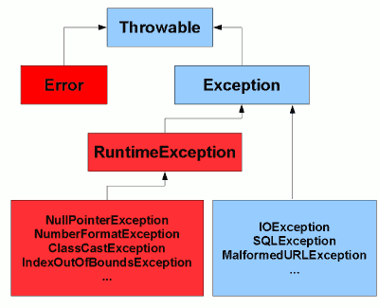
Types of exceptions
Bullet examples
Checked exceptions – should be cached/handled (e.g.: I/O Exceptions)
Unchecked exceptions – don’t need to be handled, usually they mean there is a bug in the code that needs to be fixed (e.g.: NullPointerException)
Errors – serious system issues that usually cannot be handled (e.g.: OutOfMemoryError)
Notes:
Standard text slide (version 5)
Creating visual differences in text-heavy pages keeps the audience interested and engaged.
Using bold and highlighted coloured text draws the reader into the important part of the text. Use this sparing throughout the text, if it is used too much, the page becomes busy, it loses its’ meaning.
Varying the length of the paragraphs as well as using bulleted and numeric lists help with keeping the reader engaged. Lists help to “skim” the information on the page and allow the audience to absorb a just the key information.

Slide 42
9
Functional programming in Java
Code examples in package section9_functional
Notes:
Chapter Intro Slide (version C)
This slide should be used at the beginning of each “chapter” of your presentation (as introduced in the Agenda slide) to keep the audience aware of their place in the story and to help break things up. Change the text and chapter number accordingly. If you do not need a sub-head (the smaller text), delete it. Use different backgrounds for different chapter titles, try not to repeat a background.
Very short presentations (< ~10 slides) may not need Chapter Intro Slides.
There are multiple versions of this template with various white and black background images starting on slide 10.

Slide 43
Functional programming
Bullet examples
Since Java 8, functional programming was made available
Lambda – anonymous function
Functional interface – interface that contains exactly one abstract method (@FunctionalInterface)
Stream<T> (java.util.stream)
Stream operations can be:
Intermediary (map, filter, sort) -> they return a new stream; they can be chained
Terminal (collect, match, count, reduce) -> they return a result
Notes:
Standard text slide (version 5)
Creating visual differences in text-heavy pages keeps the audience interested and engaged.
Using bold and highlighted coloured text draws the reader into the important part of the text. Use this sparing throughout the text, if it is used too much, the page becomes busy, it loses its’ meaning.
Varying the length of the paragraphs as well as using bulleted and numeric lists help with keeping the reader engaged. Lists help to “skim” the information on the page and allow the audience to absorb a just the key information.

Slide 44
10
Reflection
Code examples in package section10_reflection
Notes:
Chapter Intro Slide (version C)
This slide should be used at the beginning of each “chapter” of your presentation (as introduced in the Agenda slide) to keep the audience aware of their place in the story and to help break things up. Change the text and chapter number accordingly. If you do not need a sub-head (the smaller text), delete it. Use different backgrounds for different chapter titles, try not to repeat a background.
Very short presentations (< ~10 slides) may not need Chapter Intro Slides.
There are multiple versions of this template with various white and black background images starting on slide 10.

Slide 45
Reflection
Bullet examples
allows us to inspect or/and modify runtime attributes of classes, interfaces, fields, and methods.
Useful when we don't know their names at compile time.
Package: java.lang.reflect
With reflection we can:
Access / get / set fields (including private ones)
Access / call methods, constructors
Access super classes, annotations
Notes:
Standard text slide (version 5)
Creating visual differences in text-heavy pages keeps the audience interested and engaged.
Using bold and highlighted coloured text draws the reader into the important part of the text. Use this sparing throughout the text, if it is used too much, the page becomes busy, it loses its’ meaning.
Varying the length of the paragraphs as well as using bulleted and numeric lists help with keeping the reader engaged. Lists help to “skim” the information on the page and allow the audience to absorb a just the key information.

Slide 46
Resources
Bullet examples
https://www.baeldung.com/java-reflection
https://docs.oracle.com/javase/tutorial/reflect/index.html
Notes:
Standard text slide (version 5)
Creating visual differences in text-heavy pages keeps the audience interested and engaged.
Using bold and highlighted coloured text draws the reader into the important part of the text. Use this sparing throughout the text, if it is used too much, the page becomes busy, it loses its’ meaning.
Varying the length of the paragraphs as well as using bulleted and numeric lists help with keeping the reader engaged. Lists help to “skim” the information on the page and allow the audience to absorb a just the key information.

Slide 47
12
Multithreading
Code examples in package section12_threads
Notes:
Chapter Intro Slide (version C)
This slide should be used at the beginning of each “chapter” of your presentation (as introduced in the Agenda slide) to keep the audience aware of their place in the story and to help break things up. Change the text and chapter number accordingly. If you do not need a sub-head (the smaller text), delete it. Use different backgrounds for different chapter titles, try not to repeat a background.
Very short presentations (< ~10 slides) may not need Chapter Intro Slides.
There are multiple versions of this template with various white and black background images starting on slide 10.

Slide 48


